Slide 1
Loyola Schools Parking Lot Management System
Technology Plan

Slide 2

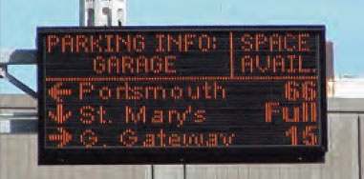
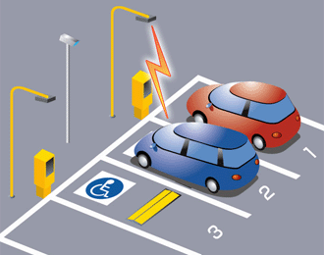

Slide 3
Implementation Plan
Development
8 months
Implementation
2 months
Maintenance and Support
Vendor customer support

Slide 4
Financials
0.015% Tuition fee increase
Payback Period
3.06 years
COSTS (Monthly):
 | Development | Production
Hardware | 9,039.54 | 0.00
Software | 16,666.67 | 0.00
Personnel | 0.00 | 13,500.00
BENEFITS (Monthly): |  | 20,000.00
Scenario Values:
Development Period (Months): |  | 8
Interest Rate (Annual): |  | 5.0%
Projected Changes (Annual)
Production Costs: |  | 5.0%
Production Benefits: |  | 3.0%

Slide 5
Financials
PROJECTED COSTS:
 | Year 0 | Year 1 | Year 2 | Year 3 | Year 4 | Year 5
Hardware | 72,316.33 | 0.00 | 0.00 | 0.00 | 0.00 | 0.00
Software | 133,333.33 | 0.00 | 0.00 | 0.00 | 0.00 | 0.00
Personnel | 0.00 | 162,000.00 | 170,100.00 | 178,605.00 | 187,535.25 | 196,912.01
Annual Costs | 205,649.67 | 162,000.00 | 170,100.00 | 178,605.00 | 187,535.25 | 196,912.01
NPV of Annual Costs | 205,649.67 | 154,285.71 | 154,285.71 | 154,285.71 | 154,285.71 | 154,285.71
NPV of Cumulative Costs | 205,649.67 | 359,935.38 | 514,221.10 | 668,506.81 | 822,792.52 | 977,078.24
PROJECTED BENEFITS:
 | Year 0 | Year 1 | Year 2 | Year 3 | Year 4 | Year 5
Annual Gross | 0.00 | 240,000.00 | 247,200.00 | 254,616.00 | 262,254.48 | 270,122.11
NPV of Annual Gross | 0.00 | 228,571.43 | 224,217.69 | 219,946.87 | 215,757.41 | 211,647.74
NPV of Cumulative Gross | 0.00 | 228,571.43 | 452,789.12 | 672,735.99 | 888,493.40 | 1,100,141.14
Annual Net | (205,649.67) | 78,000.00 | 77,100.00 | 76,011.00 | 74,719.23 | 73,210.10
NPV of Annual Net | (205,649.67) | 74,285.71 | 69,931.97 | 65,661.16 | 61,471.70 | 57,362.03
NPV of Cumulative Net* | (205,649.67) | (131,363.95) | (61,431.98) | 4,229.18 | 65,700.88 | 123,062.91

Slide 6
Expansion
All parking lots within Ateneo

